Slide 1
Daemons, Broadcasting Pipes Application Rahul shinde 006948956 CSCI 511

Slide 2
Socket()
create an endpoint for communication
Syntax :
int socket(int domain, int type, int protocol);
The socket() function shall create an unbound socket in a communications domain, and return a file descriptor that can be used in later function calls that operate on sockets.

Slide 3
Socket() (continued)
Domain : Specifies the communications domain in which a socket is to be created.
Type : Specifies the type of socket to be created.
Protocol : Specifies a particular protocol to be used with the socket.
Upon successful completion, socket() shall return a non-negative integer, the socket file descriptor. Otherwise, a value of -1 shall be returned and errno set to indicate the error.

Slide 4
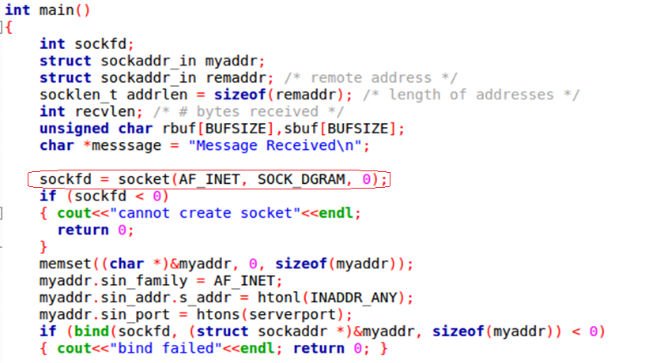
Socket() Source Code

Slide 5
Setsockopt()
set options on sockets
Syntax:
int setsockopt(int sockfd, int level, int optname, const void *optval, socklen_t optlen);
setsockopt() manipulate options for the socket referred to by the file descriptor sockfd.
Options may exist at multiple protocol levels; they are always present at the uppermost socket level.

Slide 6
Bind()
bind a name to a socket
Syntax:
int bind(int socket, const struct sockaddr *address, socklen_t address_len);
The bind() function shall assign a local socket address address to a socket identified by descriptor socket that has no local socket address assigned.

Slide 7
Bind() (continued)
Specifies the file descriptor of the socket to be bound.
Socket : Specifies the file descriptor of the socket to be bound.
Address : Points to a sockaddr structure containing the address to be bound to the socket.
address_len : Specifies the length of the sockaddr structure pointed to by the address argument.

Slide 8
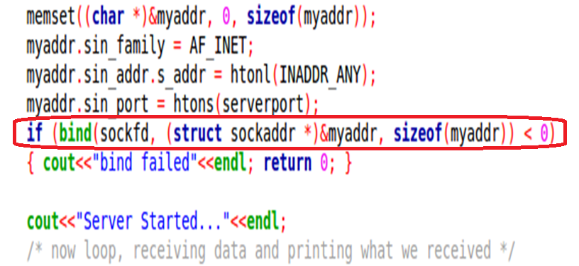
Bind() Source Code

Slide 9
Recvfrom()
receive a message from a socket
Syntax:
ssize_t recvfrom(int socket, void *restrict buffer, size_t length, int flags, struct sockaddr *restrict address, socklen_t *restrict address_len);
The recvfrom() function shall receive a message from a connection-mode or connectionless-mode socket.
Socket : Specifies the socket file descriptor.

Slide 10
Recvfrom() (continued)
Buffer : Points to the buffer where the message should be stored.
Length : Specifies the length in bytes of the buffer pointed to by the buffer argument.
Flags : Specifies the type of message reception.
Address : A null pointer, or points to a sockaddr structure in which the sending address is to be stored.
address_len : Specifies the length of the sockaddr structure pointed to by the address argument.

Slide 11
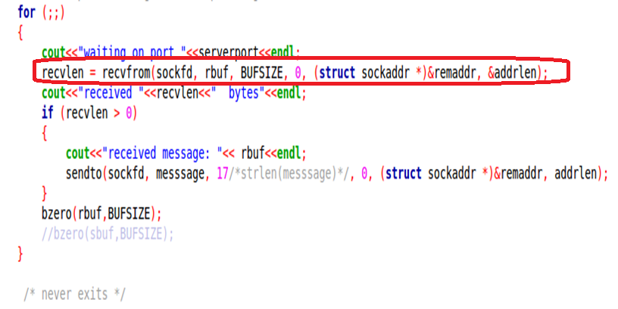
Recvfrom() Source Code

Slide 12
Sendto()
send a message on a socket
Syntax :
ssize_t sendto(int socket, const void *message, size_t length, int flags, const struct sockaddr *dest_addr, socklen_t dest_len);
The sendto() function shall send a message through a connection-mode or connectionless-mode socket.
Socket : Specifies the socket file descriptor.

Slide 13
Sendto() (continued)
Message : Points to a buffer containing the message to be sent.
Length : Specifies the size of the message in bytes.
Flags : Specifies the type of message transmission.
dest_addr : Points to a sockaddr structure containing the destination address.
dest_len : Specifies the length of the sockaddr structure pointed to by the dest_addr argument.

Slide 14
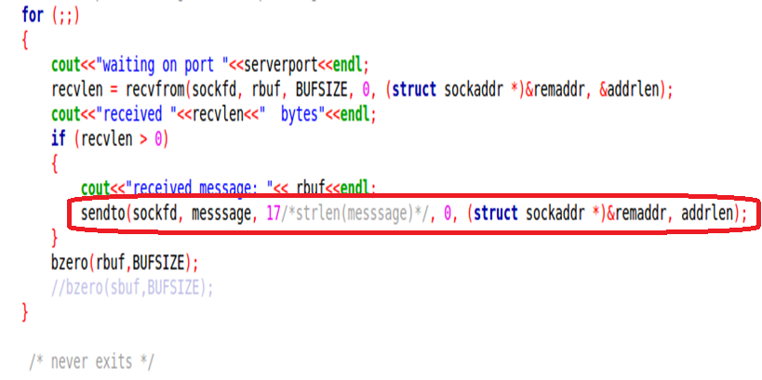
Sendto() Source Code

Slide 15
Bzero()
memory operations
Syntax :
void bzero(void *s, size_t n);
The bzero() function shall place n zero-valued bytes in the area pointed to by s.
The bzero() function shall not return a value.

Slide 16
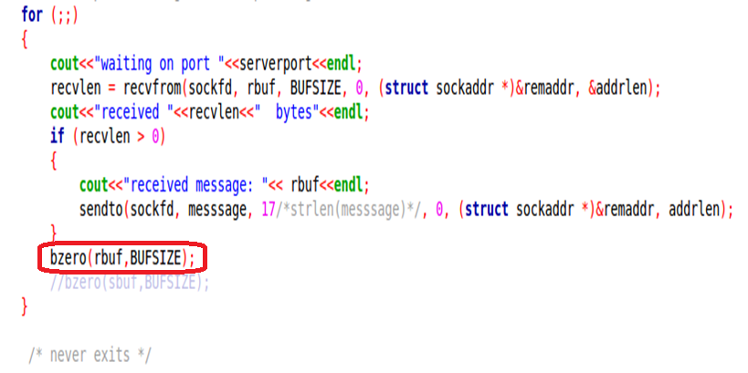
Bzero() Source Code

Slide 17
Gethostbyname()
network host database function
Syntax :
struct hostent *gethostbyname(const char *name);
This function shall retrieve information about hosts.
The gethostbyname() function shall return an entry containing addresses of address family AF_INET for the host with name name.

Slide 18
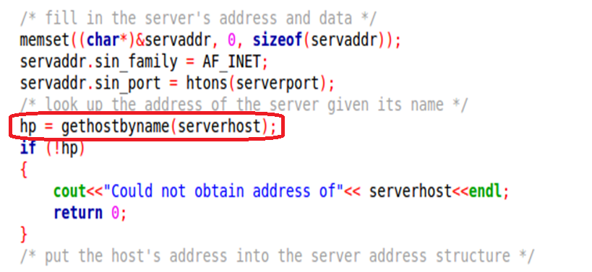
Gethostbyname() Source Code

Slide 19
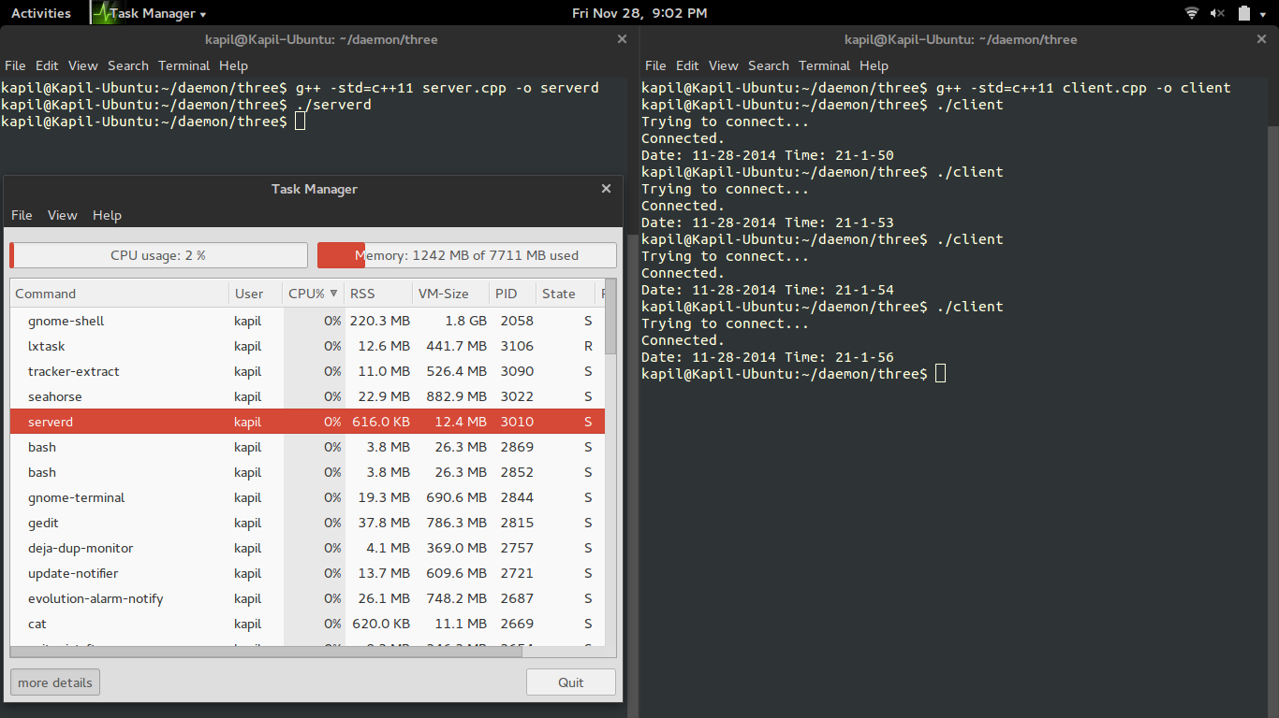
Output
Running Daemon :

Slide 20
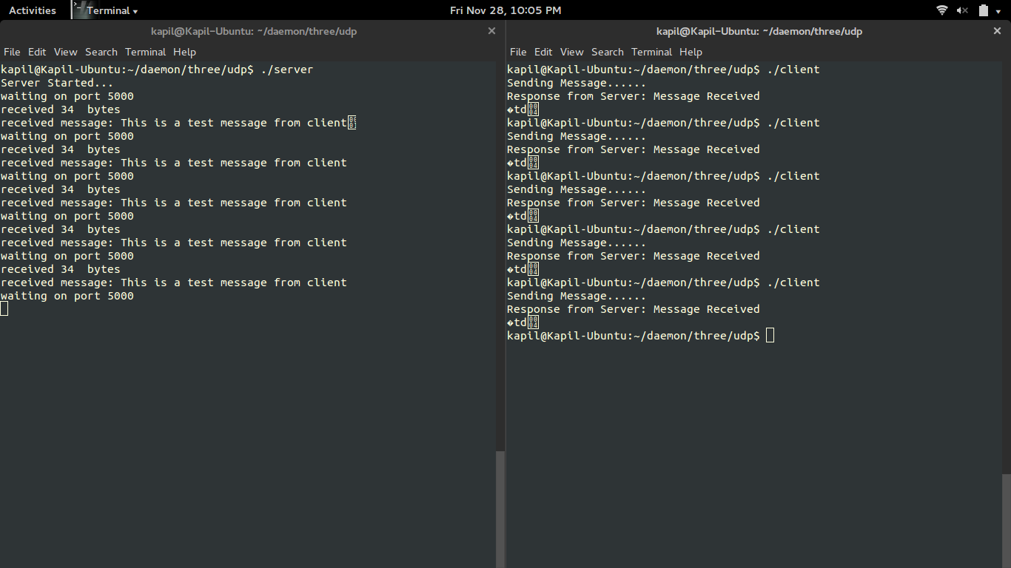
Output
Output of UDP :

